Slide 1
Control Statements
Introduction to Programming with C

Slide 2
Three Types of Control Statement
Unconditional:
goto
break
return
continue
Conditional:
if
If-else
nested if
Switch case
Iterative:
for loop
while loop
do-while loop

Slide 3
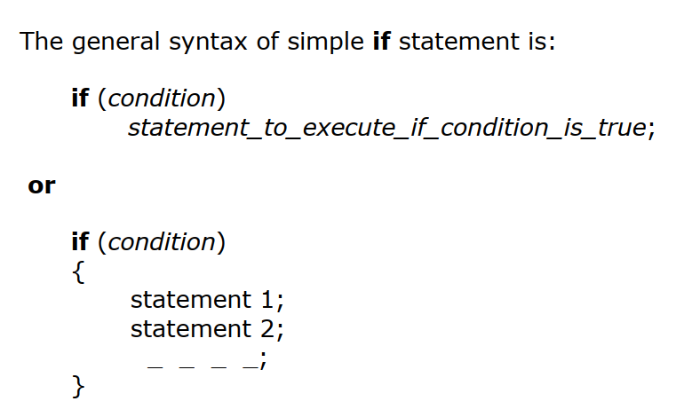

Slide 4
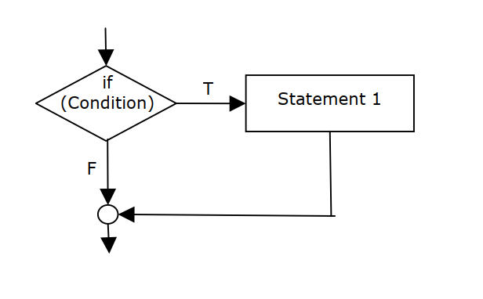
Flowchart Representation

Slide 5
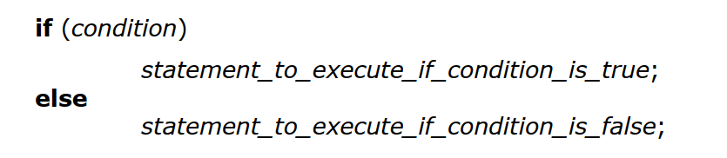
Code Syntax

Slide 6
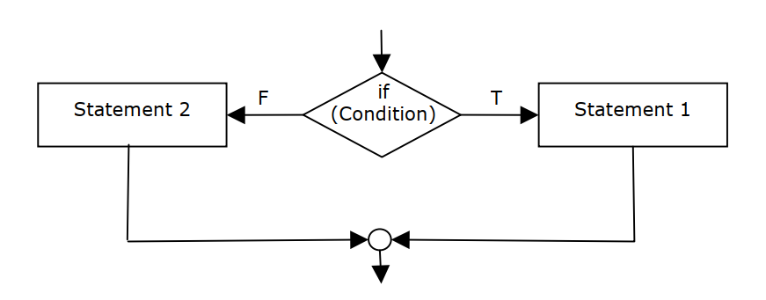
Flowchart

Slide 7
Programming Demo
Demonstration of Simple If and If-Else in the class Write a program to find if a user given number is positive or negative.

Slide 8
Programming Demo
Demonstration of nested if in the class Write a program to find if a user given number is positive or Negative. Further, for positive numbers, your program should give whether it is even or odd or zero.

Slide 9
Programming Exercise
Write a program to read three sides of a triangle and identify if the triangle is equilateral, isosceles or scalene. Make implementation of simple if and if-else to practice two forms of solution.

Slide 10
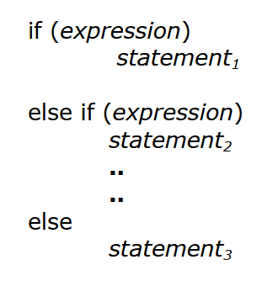
If-else ladder

Slide 11
Programming Exercise
Write a program to read a number. Based on the number entered, your program should identify which day of the week it is. Check for invalid input too.

Slide 12
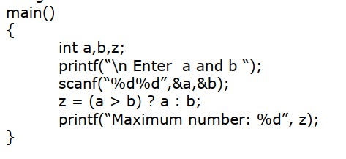
? : Operator

Slide 13
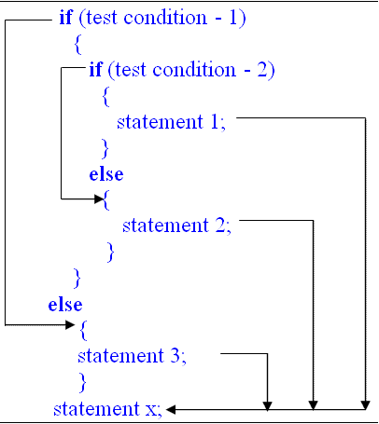
Nested If Statement

Slide 14
Programming Exercise
Write a program to read the age from the user. Your program should check if the user is eligible to vote or not.

Slide 15
Programming Exercise
Write a program to read the age from the user. Your program should decide if the user is a child (under 12 years), a teen (13 to 18 years), adult (19-55 years) or a senior citizen (above 55 years).

Slide 16
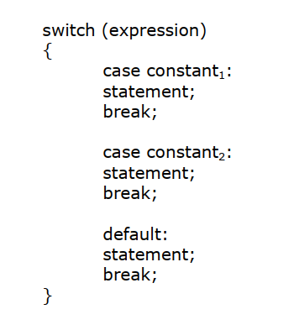

Slide 17
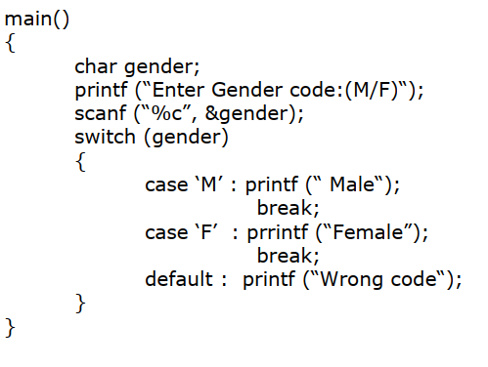

Slide 18
Programming Exercise
Admission to a professional course is subject to the following:
Marks in Mathematics >=60
Marks in Physics >=50
Marks in Chemistry >=40
Total in all three subjects >=200 (or)
Total in mathematics and physics >=150 Given the marks in the three subjects, write a program to process the application to list the eligible candidates.

Slide 19
Iterative Statements (Looping)
The process of repeatedly executing a block of statements is known as looping.
The statements in the block may be executed any number of times, from zero to infinite number. If a loop continues forever, it is called infinite loop.
You could get into infinite loops more than you think, if you are not careful with your loop conditions. And trust me, nobody likes infinite loops just like that.

Slide 20
Understanding a loop
In looping, a sequence of statements are executed until some conditions for the termination of the loop are satisfied. A program loop therefore consists of two segments, one known as the body of the loop and the other known as the control statement
The Control Statement tests certain conditions and then directs the repeated execution of the statements contained in the body of the loop.
Depending on the position of the control statement in the loop, a control structure may be classified either as the entry controlled loop or as exit-controlled loop.

Slide 21
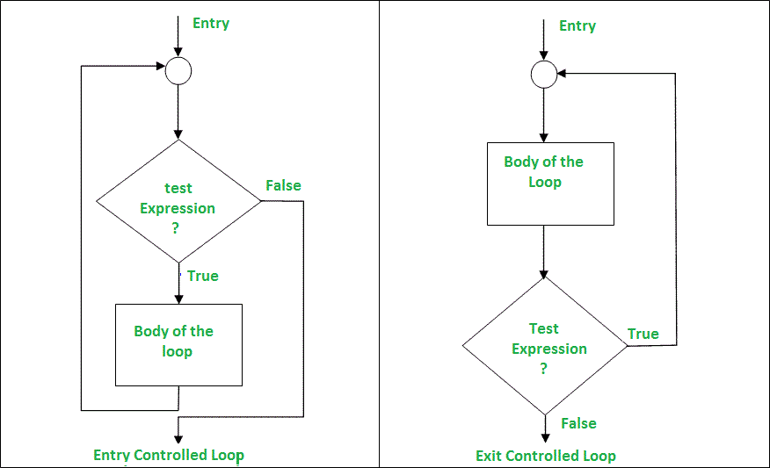
Entry vs Exit Controlled

Slide 22
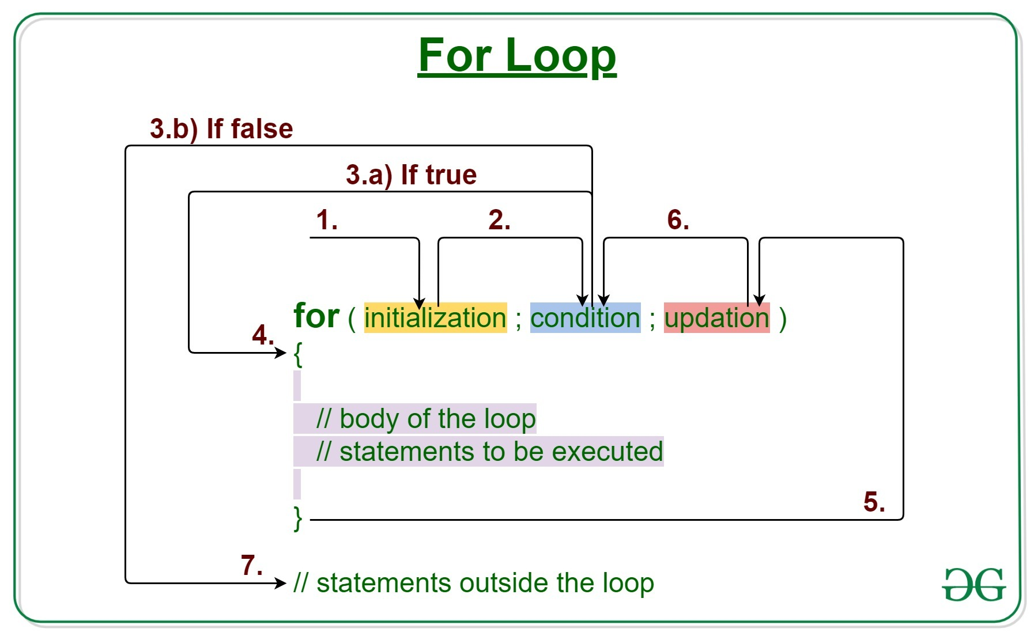
For Loop

Slide 23
For Loop
for ( Starting value ; Exit Value ; Transition Value) { Body of the loop }
Example: for(i=1 ; i<10 ; i++) for (int j=0; j<=9 ; j++)

Slide 24
For Loop Programming Demo In the Class

Slide 25
Programming Exercise
Write a program to find all the even numbers from 0 to 20, 20 inclusive.
WAP to compute all the numbers divisible by 7 in between the range 100 to 700, both inclusive.

Slide 26
Programming Exercise
Write a program to generate the following pattern: 1 11 111 1111 11111 upto n number of terms

Slide 27
Programming Exercise
Write a program to generate the following pattern: 1 121 12321 1234321 123454321 upto n number of terms

Slide 28
Programming Exercise
Write a program to generate the following pattern: 12345 1234 123 12 1

Slide 29
Programming Exercise
Write a program to generate the following pattern: 1 12 123 1234 12345

Slide 30
Programming Exercise
Write a program to generate the following pattern: 1 21 321 4321 54321

Slide 31
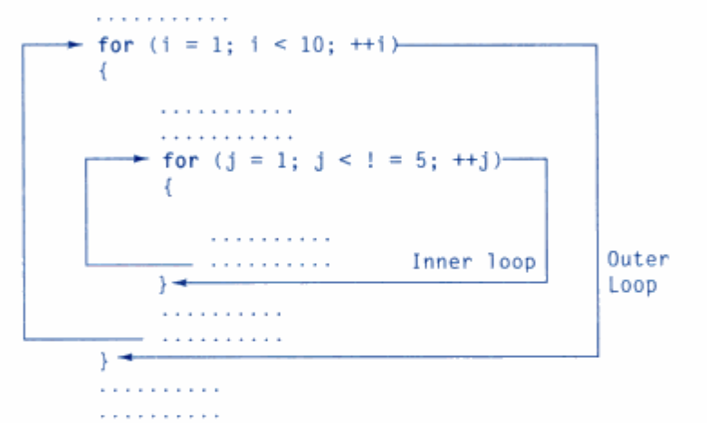
Nesting of For Loops

Slide 32
Programming Exercise
Write a program to generate the following pattern: * ** *** **** *****

Slide 33
Programming Exercise
Write a program to generate the following pattern: 1 12 123 1234 12345

Slide 34
Programming Exercise
Write a program to generate the following pattern: 1 12 123 1234 12345 1234 123 12 1

Slide 35
Programming Exercise
Write a program to generate the following pattern: * ** *** **** ***** * ** *** **** ***** * * * * *

Slide 36
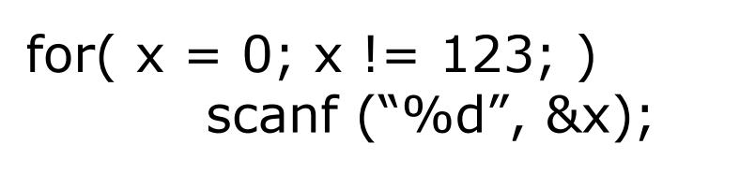
Evaluate the Code Exercise:

Slide 37
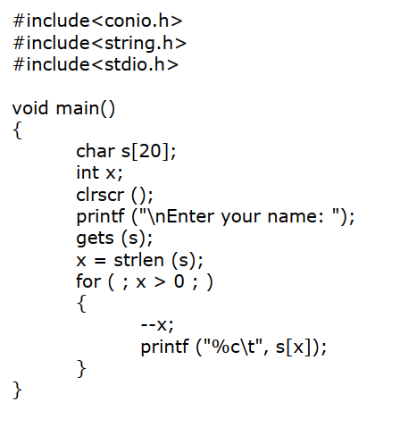
Evaluate the Code Exercise

Slide 38
while loop
Initialization while (test condition) { Body of the loop }
While loop is an entry controlled loop.

Slide 39
Programming Demo of while loop in the class

Slide 40
Changing for with while
Can you re-write a couple of previous for-loop exercise using while loop?
Did you implement nested while loops?

Slide 41
do-while loop
Initialization do { Body of the loop } while (test condition);
Do-While loop is an exit controlled loop.

Slide 42
Programming Demo of do-while loop in the class

Slide 43
Changing for with do-while
Can you re-write a couple of previous for-loop exercise using do- while loop?
Did you implement nested do-while loops?

Slide 44
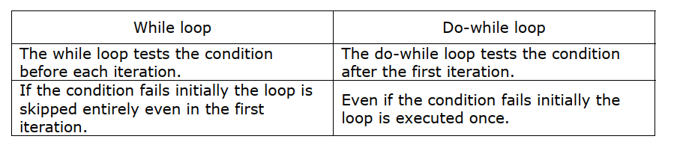
Difference Between While and Do-While

Slide 45
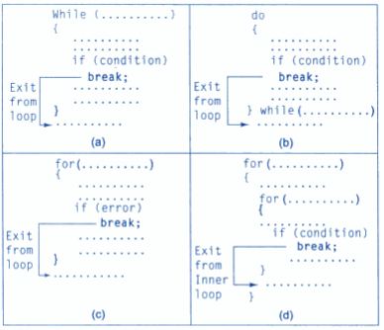
Breaking Out of a Loop

Slide 46
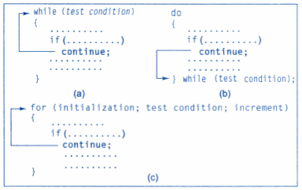
Bypassing a loop

Slide 47
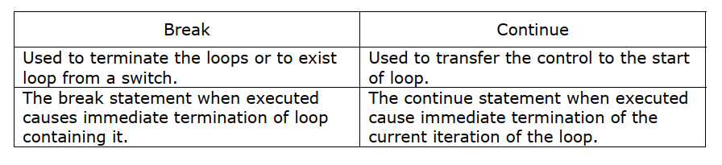
Break Vs Continue

Slide 48
More Practice Questions
WAP (Write A Program) to find the sum of natural numbers from 1 to n.
WAP to find the sum of squares of a number from 1 to n.
WAP to find the sum of cubes of a number from 1 to n.
WAP to calculate the multiplication table of a user given number, in a tabular format.

Slide 49
More Practice Questions
WAP to count the number of digits in a user given number.
WAP to find the sum of the digits in a user given number.
WAP to swap the first and the last digit of a user given number.
WAP to print the user given number in the reverse order.
WAP to check whether a number is palindrome or not. A palindrome is a number that comes to be same when read forward or backward. Eg: 131 is a palindrome, 124 is not. 14541 is a palindrome, 234123 is not.

Slide 50
More Practice Questions
WAP that reads a number ‘a’ and its nth power ‘n’. Your program should calculate the nth power of a without using pow() function, by simply using loop.
WAP to find the factorial (denoted by !) of a number. 5!= 5*4*3*2*1 3!=3*2*1 10!=10*9*8*…..*4*3*2*1
WAP to check whether a number is prime or not.
WAP to print the Fibonacci numbers up to n. Fibonacci series: 0 1 1 2 3 5 8 13 21 34 55 ….. Up to n terms

Slide 51
Some More Practice Questions
WAP to check whether a number is Armstrong or not. A Armstrong number is the sum of cubes of the digits in it. Eg: 153 is the sum of 1^3, 5^3 and 3^3.
WAP to find the sum of prime numbers between two numbers a and b. Your program should read the value of a and b from the user, then identify all the prime numbers in between the range and then calculate the some of all the prime numbers.

